Slide 1
No-Scalpel Vasectomy “The ABCs of Vasectomy”
Lusaka, Zambia
2023
Michel Labrecque MD PhD
John Curington MD

Slide 2
Disclosures
Nothing to disclose.
No financial gain. We do this because it’s important.

Slide 3
Elizabeth and Peter
The couple comes to you for their 2 week old’s well child visit. E, a 28 year old G3P3, asks about pain at her c-section incision site. Healing well.
You ask what they use or plan to use for birth control. They are at a loss.
Pregnancy was unintended, and occurred after copper IUD expulsion. They want no more children. E has migraine headaches with visual aura.
Peter is worried about Elizabeth- says they can’t have another child. What are Elizabeth’s options?
Notes:
Migraine with aura is 4 for COCs on US MEC chart
2 articles list previous expulsion as risk factor for future IUD expulsion
CIN isn’t a contraindication for IUD, but cervical cancer is

Slide 4
Elizabeth and Peter
Why do we ask first about Elizabeth?
Is this gender bias?
What are the options for the couple?
What is the role of the man in contraception?
Notes:
Migraine with aura is 4 for COCs on US MEC chart
2 articles list previous expulsion as risk factor for future IUD expulsion
CIN isn’t a contraindication for IUD, but cervical cancer is

Slide 5
Organization
definition
background
how to do a vasectomy
how to counsel

Slide 6
Vasectomy
Definition:
A vasectomy is a surgical procedure that cuts and/or blocks the vasa for the purpose of permanent contraception.

Slide 7
Why Vasectomy?
Permanent
Convenient
Reliable
Safe
Cost effective
Notes:
Failure rate over first year - 0.15% vs. 0.5% for BTL. Comparable to implanon. Nothing else better.
-2nd most cost-effective contraception (after copper IUD)
Average vasectomy $500 (BTL $1300)
Overall cost savings of vasectomy compared to no contraceptive use over 5 years ~$14,000
Trussell J, The economic value of contraception: a comparison of 15 methods, American Journal of Public Health, 1995, 85(4):494–503.; Bartz, Rev Obstet Gynecol 2008

Slide 8
Use of Vasectomy
Vasectomies are performed all over the world
500,000 vasectomies per year in US
60,000 vasectomies per year in Canada
Notes:
Barone MA, Hutchinson PL, Johnson CH et al: Vasectomy in the United States, 2002. J Urol 2006; 176: 232.

Slide 9
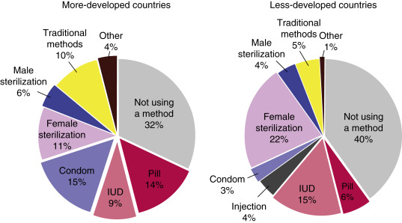
Use of Vasectomy Worldwide
Population Reference, 2004. Bureau transitions in world population. Popul. Bull. 59, 1–40.
Notes:
Chandra A, Martinez GM, Mosher WD et al: Fertility, family planning, and reproduction health of U.S. women: data from the 2002 National Survey of Family Growth. Vital and Health Statistics 2005; 23: 1.

Slide 10
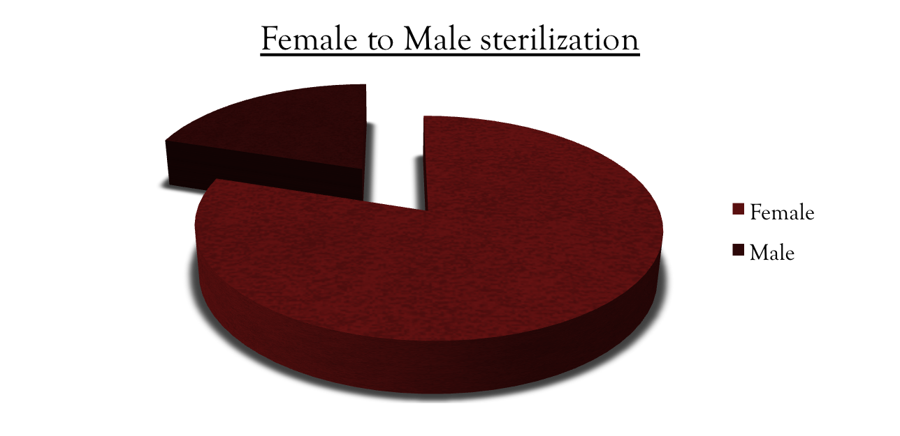
Use of Vasectomy Worldwide
Vasectomy > Tubal Ligation
New Zealand, Canada, UK, Bhutan, Denmark, Netherlands
EngenderHealth, WHO 2003
Notes:
Female sterilization exceeds Male sterilization 5:1. Yet compared to BTL, NSV has fewer complications, lower failure rate (0.15% v 0.5%), and lower cost. (Trussell, Contraception 2004, Jamieson Ob Gyn 2004, Peterson 1996, Bartz 2008)
Source: Engender health Also, failed BTL has high risk of ectopic pregnancy, failed vasectomy has no increased risk of ectopic.
New Zealand 23%, UK 18%, US 11% (6%)

Slide 11
Vasectomy Background
You too can do vasectomies!
Urologists
Family Physicians/General Practitioners
General surgeons
Gynecologists
Notes:
Barone MA, Hutchinson PL, Johnson CH, Hsia J, Wheeler J. Vasectomy in the United States, 2002. J Urol 2006;176:232–6

Slide 12
Vasectomy Background
Vasectomy safer than tubal ligation
20 times more risk of major complication with tubal ligation
Notes:
Smith GL, Taylor GP, Smith KF. Comparative risks and costs of male
and female sterilization. Am J Pub Health 1985;75:370–4.

Slide 13
Anatomy
What is the difference between sperm and semen?
Where is sperm made?
Where is semen made?
How does the sperm get to the semen?
Notes:
Chandra A, Martinez GM, Mosher WD et al: Fertility, family planning, and reproduction health of U.S. women: data from the 2002 National Survey of Family Growth. Vital and Health Statistics 2005; 23: 1.

Slide 14
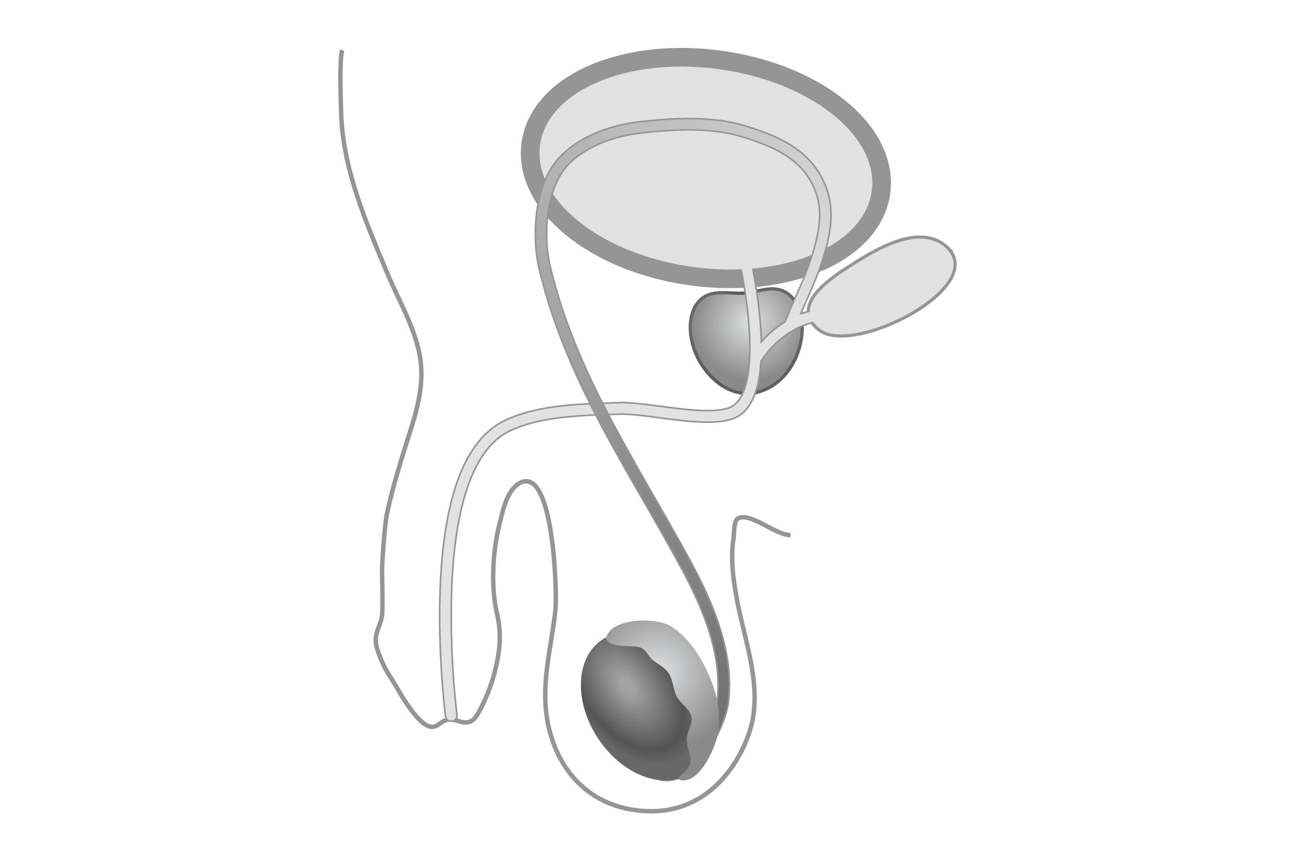
Anatomy
Notes:
Chandra A, Martinez GM, Mosher WD et al: Fertility, family planning, and reproduction health of U.S. women: data from the 2002 National Survey of Family Growth. Vital and Health Statistics 2005; 23: 1.

Slide 15
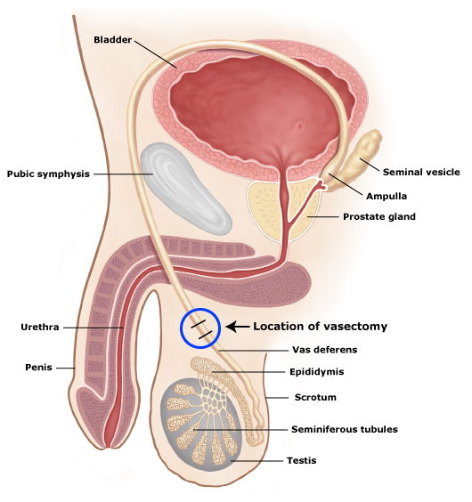
Anatomy
Notes:
Describe procedure briefly in terms of pre-and post. Preface with “This is how we describe the procedure to patients, especially to address common misconceptions…”
The easiest place to interrupt the flow of sperm in just above the testes where the vas tubes are just beneath the skin and very mobile.

Slide 16
Anatomy
Which organs push semen out during ejaculation?
Does semen change after vasectomy?
Notes:
Chandra A, Martinez GM, Mosher WD et al: Fertility, family planning, and reproduction health of U.S. women: data from the 2002 National Survey of Family Growth. Vital and Health Statistics 2005; 23: 1.

Slide 17
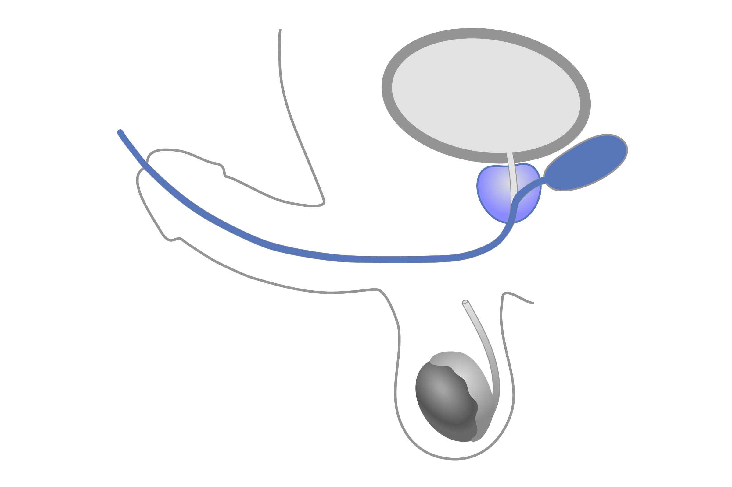
Anatomy
Notes:
Chandra A, Martinez GM, Mosher WD et al: Fertility, family planning, and reproduction health of U.S. women: data from the 2002 National Survey of Family Growth. Vital and Health Statistics 2005; 23: 1.

Slide 18
Anatomy
Where is testosterone made?
How is testosterone sent to the body, muscles, etc?
Where is the main organ of sex drive?
Why does a vasectomy not affect sex drive?
Notes:
Chandra A, Martinez GM, Mosher WD et al: Fertility, family planning, and reproduction health of U.S. women: data from the 2002 National Survey of Family Growth. Vital and Health Statistics 2005; 23: 1.

Slide 19
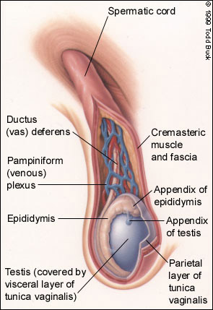
Anatomy
Notes:
Describe procedure briefly in terms of pre-and post. Preface with “This is how we describe the procedure to patients, especially to address common misconceptions…”
The easiest place to interrupt the flow of sperm in just above the testes where the vas tubes are just beneath the skin and very mobile.

Slide 20
Vasectomy Procedure
There are two main techniques:
traditional open technique
no-scalpel technique
Notes:
To access vas
Many techniques to occlude it

Slide 21
Traditional Vasectomy
a scalpel incision is made in the scrotum
the vasa are exposed and cut, tied, or otherwise blocked
the scrotum is sutured closed
Notes:
Usually 2 incisions

Slide 22
Why not use a scalpel?
Notes:
Usually 2 incisions

Slide 23
Minimally Invasive Procedures
Usually lower risk
Less chance of hurting other structures
Quicker recovery
Preferred by patients

Slide 24
No-Scalpel Vasectomy
vas is brought central with fingers
holder is applied around the vas
small puncture is made in the scrotum
vas is delivered through the puncture
vas is cut, tied, or otherwise blocked
repeat on the other side, same opening

Slide 25
Occlusion techniques
Separate
Cauterize
Interpose fascia
Notes:
Cut
Cautery
Tie or clip fascia

Slide 26
No-Scalpel vs. Traditional
Complication | No-Scalpel | Traditional
Hematoma
small superficial | 1 (0.2%) | 4 (0.7%)
small deep | 1 (0.2%) | 18 (3.3%)
large deep | 0 (0.0%) | 4 (0.7%)
unspecified | 8 (1.5%) | 41 (7.5%)
Scrotal pain
mild | 215 (39.5%) | 251 (45.8%)
moderate | 28 (5.1%) | 51 (9.3%)
severe | 4 (0.7%) | 9 (1.6%)
Infection
yes | 1 (0.2%) | 8 (1.5%)
Sokal et al. 1999
Notes:
Sokal et al, Journal of Urology, Vol. 162, 1621–1625, November 1999
Randomized trial of 1429 men at 8 sites in Brazil, Guatemala, Indonesia, Sri Lanka and Thailand.

Slide 27
No-Scalpel Vasectomy
Let’s see this in pictures

Slide 28
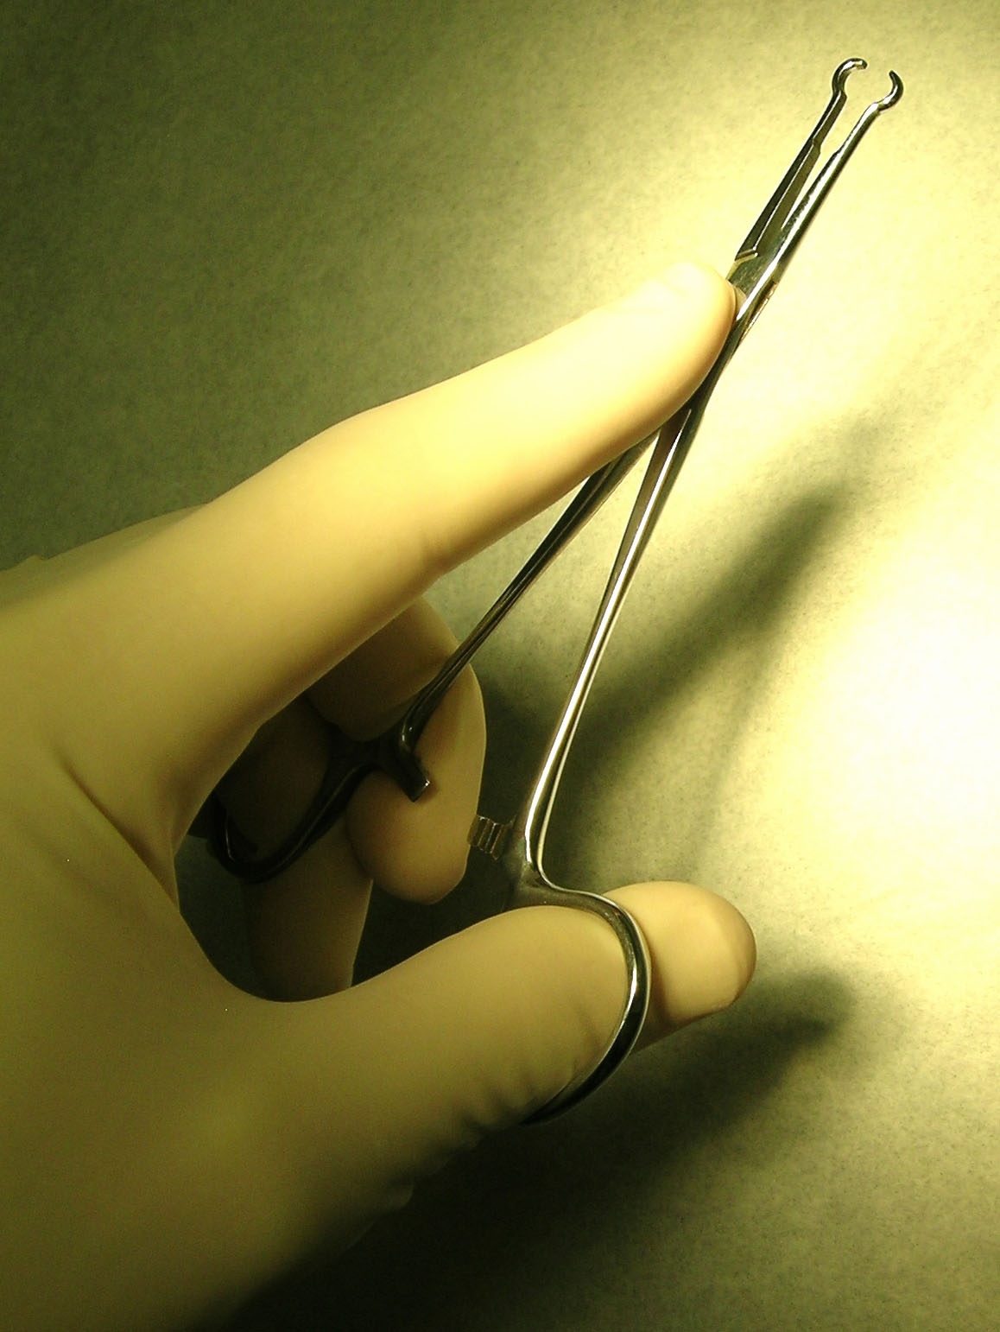
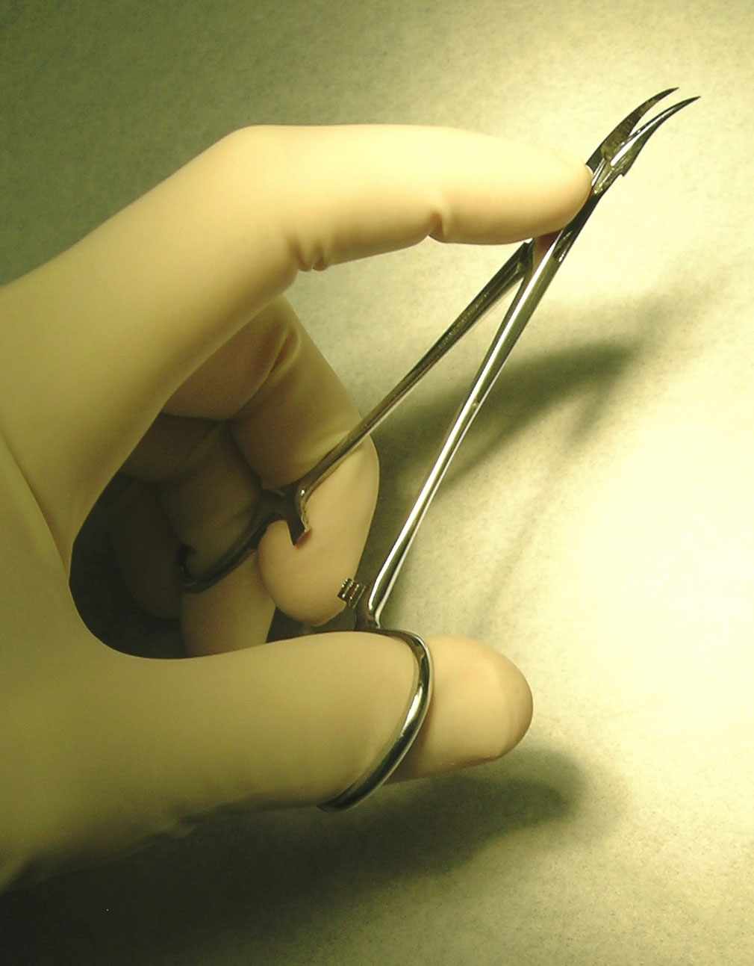
Instruments
Ring forceps
Dissecting forceps
Notes:
Extra cutaneous vas fixation forceps (ring forceps)
Dissecting forceps

Slide 29
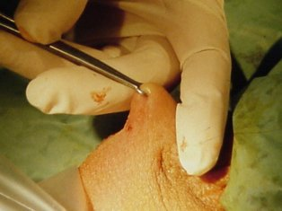
Holding the vas

Slide 30
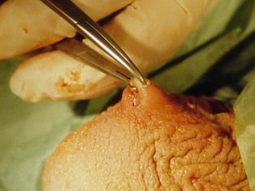
Puncturing the skin

Slide 31
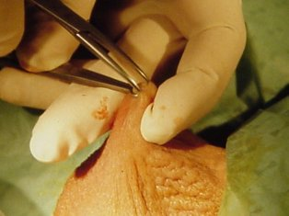
Stretching the opening

Slide 32
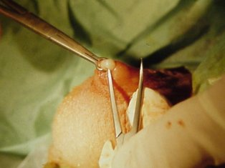
Hooking the vas

Slide 33
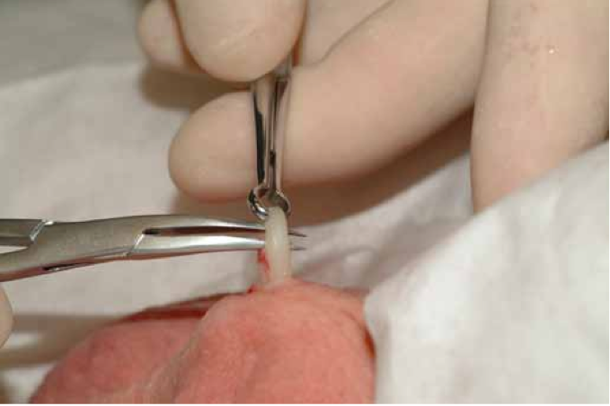
Cleaning the vas
Notes:
Next few photos are from
Vasectomy Occlusion Technique Combining Thermal Cautery and Fascial Interposition
Michel Labrecque
International Braz J Urol
Vol. 37 (5): 630-635, September - October, 2011

Slide 34
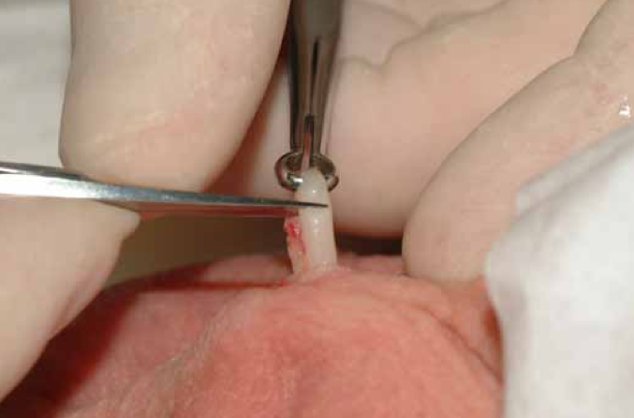
Hemi-transecting the vas

Slide 35
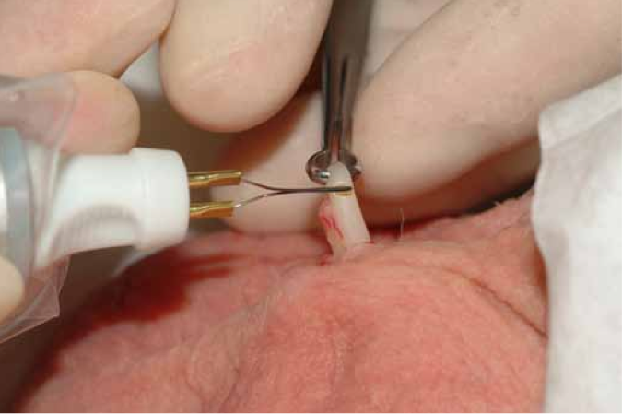
Hemi-transecting the vas

Slide 36
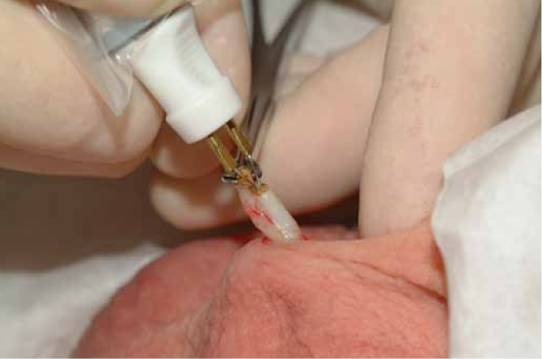
Intraluminal cautery

Slide 37
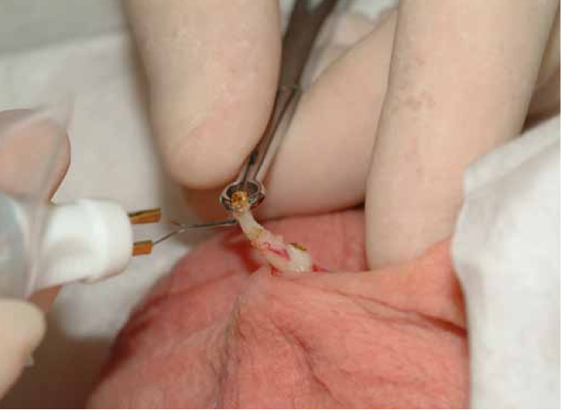
Finishing the transection

Slide 38
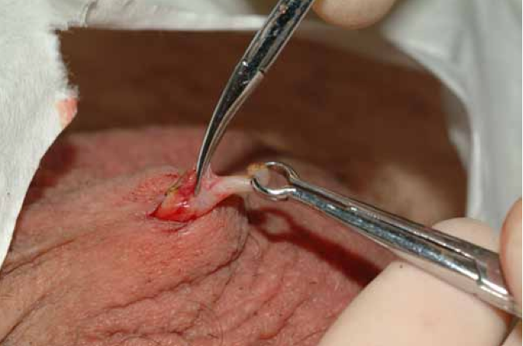
Pulling fascia over the vas

Slide 39
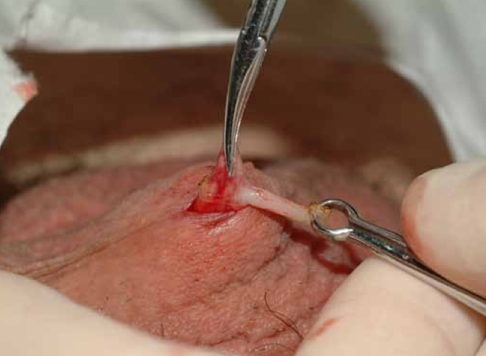
Exposing fascia to tie

Slide 40
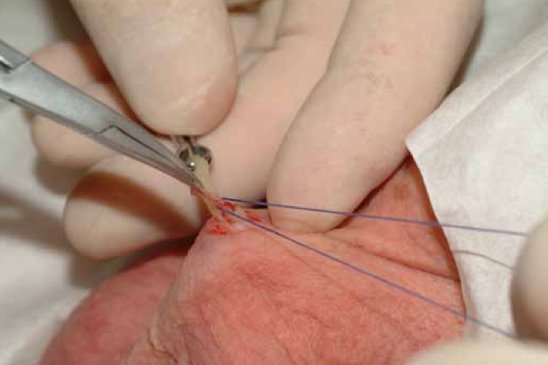
Preparing to tie the fascia

Slide 41
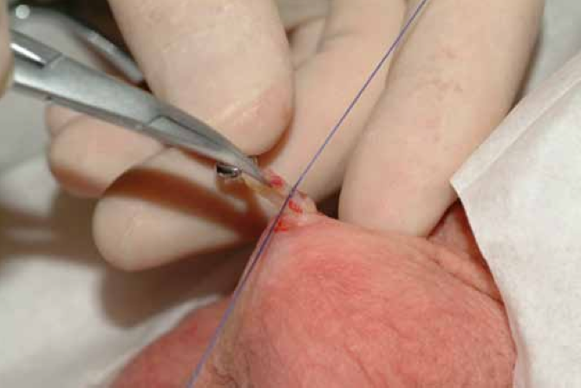
Tying the fascia

Slide 42
Finishing the other side
Of course, the procedure is repeated on the other side so that both tubes are cut.

Slide 43
No-Scalpel Vasectomy
Let’s see this in diagrams

Slide 44
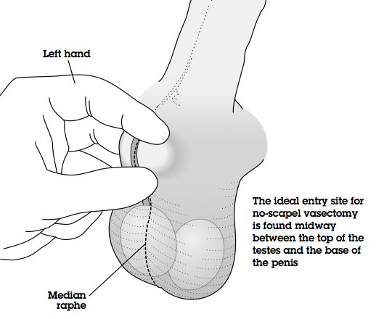
Finding the vas

Slide 45
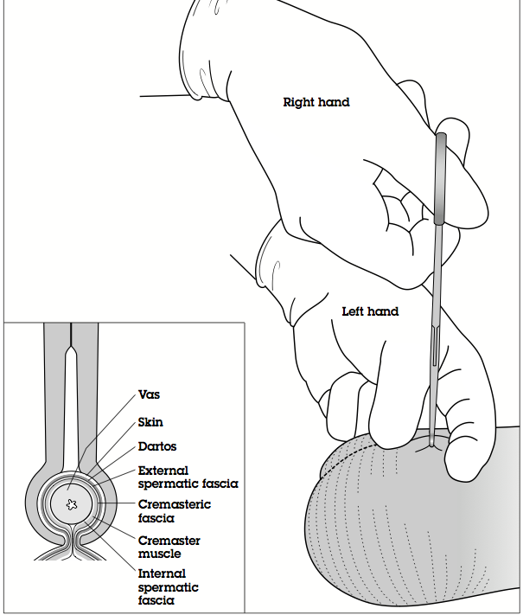
Grasping vas with ringed clamp

Slide 46
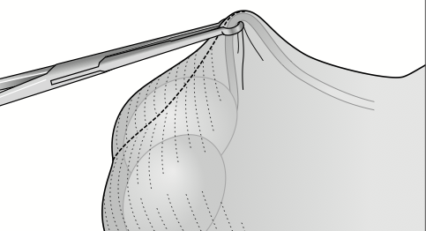
Grasping the vas

Slide 47
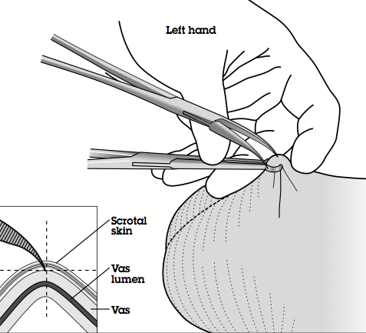
Accessing the vas

Slide 48
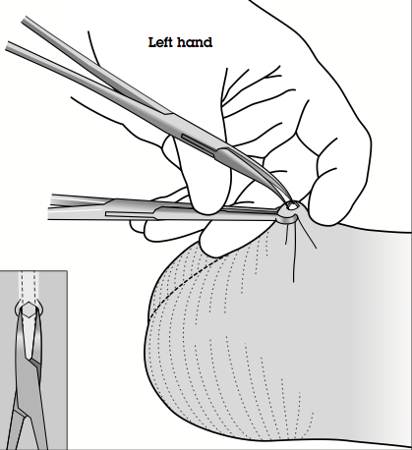
Accessing the vas

Slide 49
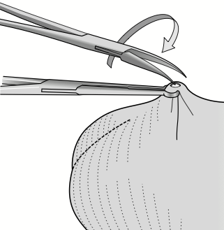
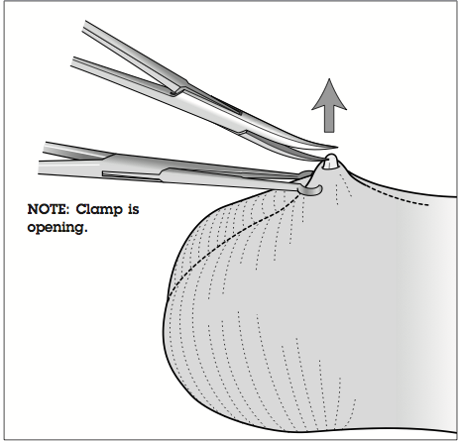
Delivering the Vas

Slide 50
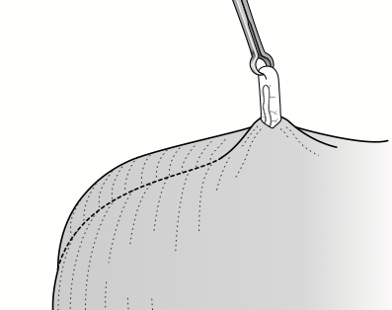
Re-grasping the vas

Slide 51
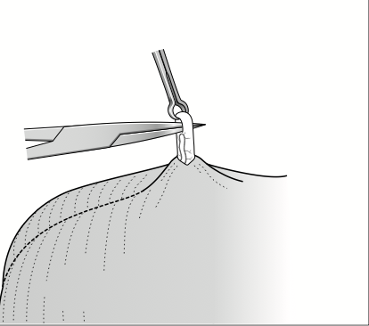
Cleaning the vas

Slide 52
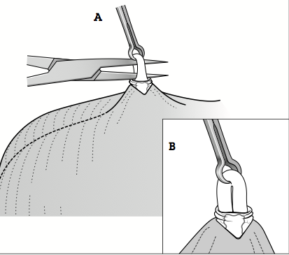
Cleaning the vas

Slide 53
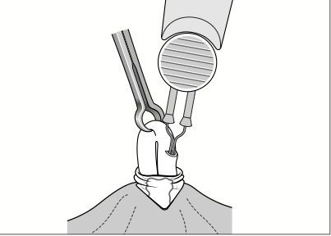
Cauterizing the vas

Slide 54
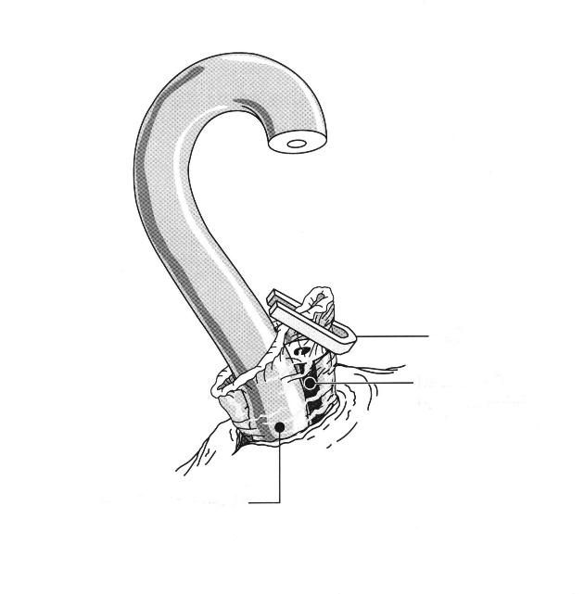
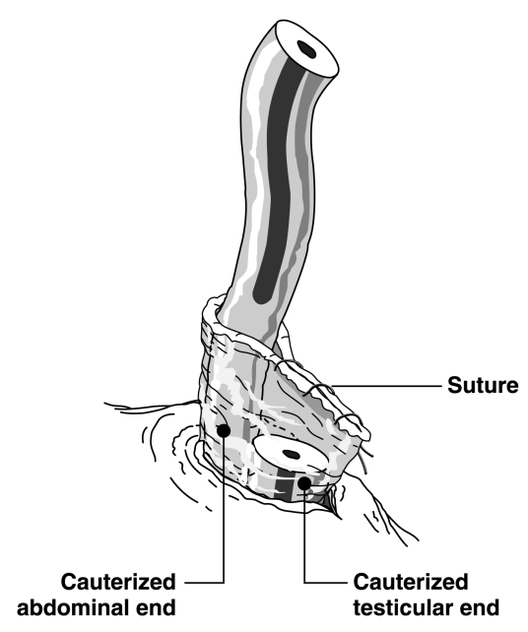
Then fascial interposition

Slide 55
Let’s see this in film
Notes:
From Michel Labrecque

Slide 56
Summary of Technique
Find vasa
Numb vasa
Grasp vas
Deliver vas
Clean vas
Cauterize, Snip, Fascial Interposition
Repeat on other side

Slide 57
Counseling for Vasectomies
pre-vasectomy
post-vasectomy

Slide 58
Pre-Vasectomy Counseling
discuss patient’s reason for procedure
use a checklist

Slide 59
Pre-Vasectomy Counseling
discuss patient’s reason for procedure
use a checklist

Slide 60
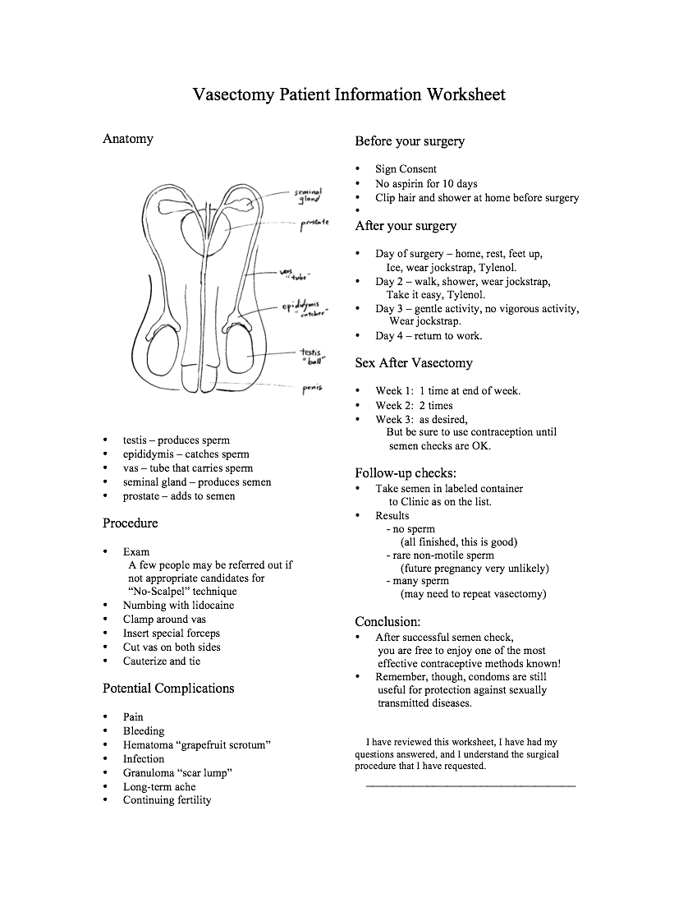
Vasectomy Counseling Checklist
simplifies your life

Slide 61
Pre-Vasectomy Counseling
discuss patient’s reason for procedure
use a checklist
know local consent laws

Slide 62
Pre-Vasectomy Counseling
discuss patient’s reason for procedure
use a checklist
know local consent laws
discuss that it is permanent and alternatives

Slide 63
Vasectomy is Essentially Permanent !
Reversals
often not available
very costly
more difficult than vasectomy (2-3 hours)
often do not work (only 50% pregnancy rate)

Slide 64
Vasectomy reversal
A man should not have a vasectomy if he is planning on having a vasectomy reversal later on.

Slide 65
Alternatives to Vasectomy
condoms
women’s contraception
abstinence

Slide 66
Pre-Vasectomy Counseling
discuss patient’s reason for procedure
use a checklist
know local consent laws
discuss that it’s permanent and alternatives
discuss benefits

Slide 67
Benefits of Vasectomy
very effective method of contraception
permanent
does not affect sexual feeling or drive
sharing of contraceptive responsability

Slide 68
Pre-Vasectomy Counseling
discuss patient’s reason for procedure
use a checklist
know local consent laws
discuss that it’s permanent and alternatives
discuss benefits
discuss risks
not immediately effective

Slide 69
Why continuing sperm?
Residual sperm
Recanalization
you missed a tube (rare)

Slide 70
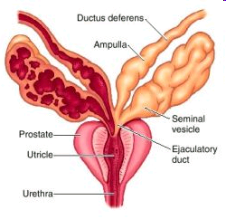
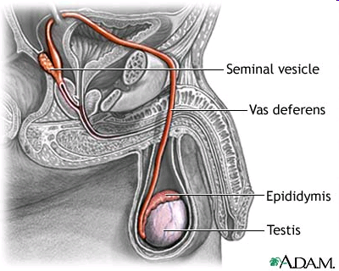
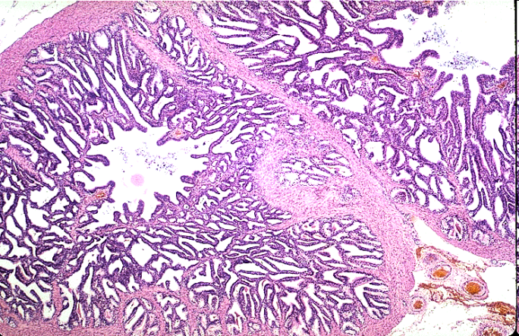

Slide 71
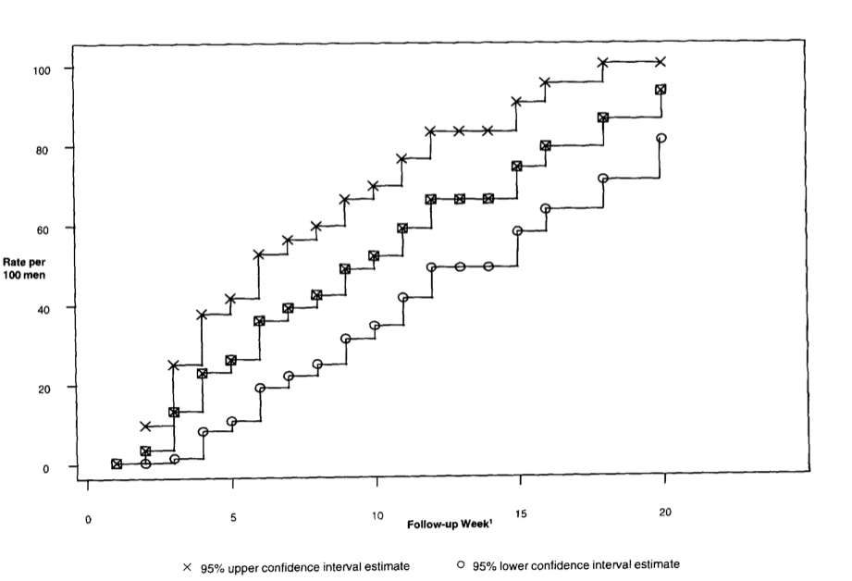
Time to Zero Sperm
percentage of men with azoospermia as the weeks pass
Certes et al. Results of a Pilot Study of the Time to Azoospermia after Vasectomy in Mexico City. Contraception. 1997
Notes:
Certes et al. Results of a Pilot Study of the Time to Azoospermia after Vasectomy in Mexico City. Contraception. 1997

Slide 72
Continuing sperm in semen
Usually because sample too early
wait three to four months
rare sperm usually cause no pregnancy
copious sperm require
retesting
repeat vasectomy if still copious

Slide 73
Pregnancy after Vasectomy
Important to counsel patients about this
1 pregnancy per 1000 vasectomies (with cautery and fascial interposition)
About ½ from sex soon after vasectomy
Remainder mostly recanalization
Notes:
Contraception Vol. 69, Issue 5, Pages 401-406

Slide 74
Recanalization
a “bridge” of scar
fibroblasts
white blood cells
epithelial cells
micro-canalization
Notes:
The exact mechanism by which the vas recanalizes after vasectomy is not fully understood. Our best evidence are based on histologic studies most performed at the time of vaso-vasostomy. Putting a suture on the vas is a tricky business. On one hand, if the sutures are too tight, they either cut through the vas or cause the necrosis of the remaining stumps. On the other hand, if the sutures are not tight enough, the lumen remains open and sperm leak. Conceptually this is what happens in both situations.
However, in reality our body does not allow empty space. Within a few days after vasectomy a connecting bridge develops between the stumps of the cut vas. This bridge consists of connective tissue, sperm debris, white blood cells, and most important epithelial cells from the vas lumen

Slide 75
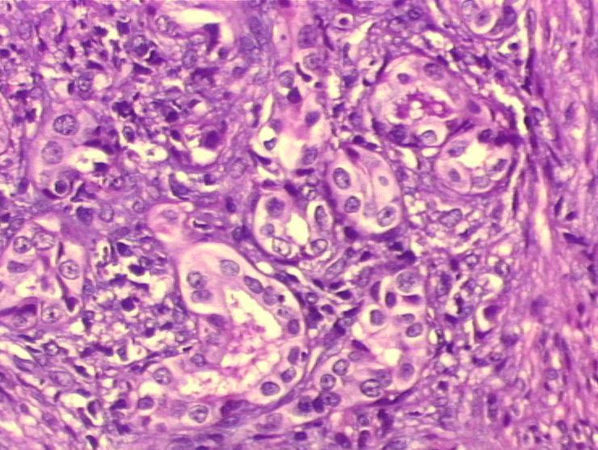
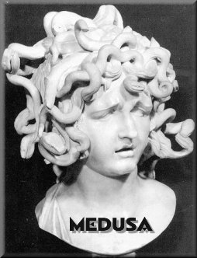
Recanalization
Proliferation of
“microtubules”
forms a
“medusa head”
Notes:
These epithelial cells proliferate through the scar tissues creating epithelial tubules and small intramural ductus as you can see on this slide. This extensive network of micro channels is known as "Medusa's head" , named after a women from the Greek mythology whose hair was changed into serpents. It is those ducts, each one searching to restore the continuity of the lumen, that are believed to be responsible for recanalization.

Slide 76
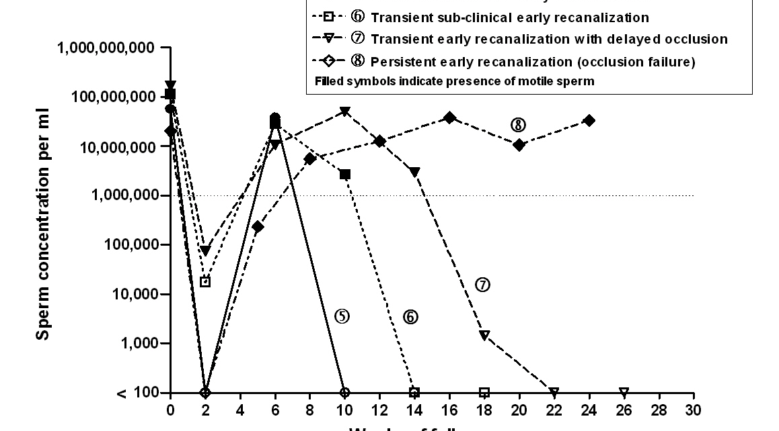
Recanalization
Notes:
Labrecque et al, BMC Urology, 2006

Slide 77
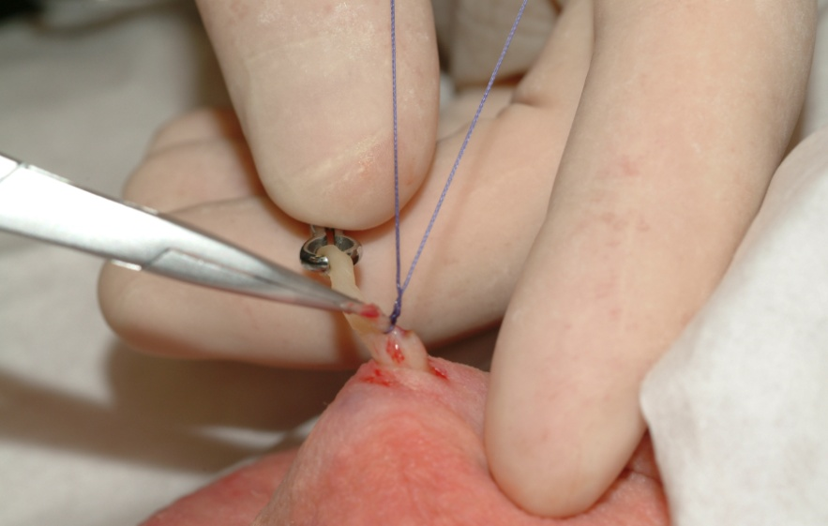
Effective Occlusion Technique to Minimize Recanalisation
Cautery + fascial interposition

Slide 78
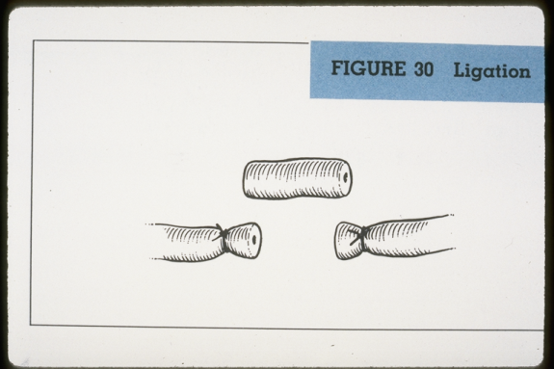
Avoid Classic Occlusion Technique (Ligation and Excision)
8% to13% failure rate

Slide 79
Recanalization
counsel your patients about this
rare, but life-changing
post-vasectomy semen check
very important!
Notes:
Labrecque et al, BMC Urology, 2006

Slide 80
Pre-Vasectomy Counseling
discuss patient’s reason for procedure
use a checklist
know local consent laws
discuss that it’s permanent and alternatives
discuss benefits
discuss risks
not immediately effective
possible complications

Slide 81
Vasectomy Possible Complications
Bleeding (1%)
Infection (1%)
Hematoma (1%)
granuloma
testicular atrophy
continuing fertility (recanalisation) (0.1%)
post-vasectomy chronic pain (1%)
regret
Notes:
Took out “unknown”
Is testicular atrophy really something you counsel about?

Slide 82
Counseling After a Vasectomy
Very important!
Prevents complications
Can save you many phone calls

Slide 83
Post-Vas Instructions
support for the scrotum
rest
when to have sex
when to shower
how to use pain medications
use contraception
when to bring back semen sample
normal post-vasectomy changes

Slide 84
Support for the scrotum
very important
snugly fitting jockstrap or tight briefs
small vessels can bleed
scrotum can fill with blood
grapefruit or eggplant scrotum
scrotum can turn purple
blood oozes up to skin

Slide 85
Rest
also very important
the testes bounce between the legs
a small vessel can ooze
less bleeding and bruising if he rests
less pain if he rests

Slide 86
When to have sex
Not much evidence here!
Most people say
1 time during first week
2 times during second week
after that, go for it!
go gently
don’t be surprised by a few drops of blood in semen at first

Slide 87
When to shower
Wait 2 or 3 days
when he showers, his testes dangle
can increase bleeding or bruising
not much evidence about infection

Slide 88
Pain medications
Most men need only ibuprofen
400 to 600mg every eight hours with food
this greatly helps the “achy” feeling
Acetaminophen also very useful
don’t exceed 3,000mg per day

Slide 89
Pain medications
Comfort care like
scrotal support
ice
rest
much more important than medications
Notes:
Remind me to tell you about the beer technique…

Slide 90
Contraception
After a vasectomy the man is still fertile for a few months!
Sperm can hide in
the tubes
the prostate
the seminal vesicles

Slide 91
Contraception
He must continue to use contraception after his vasectomy until his semen analysis is clear!

Slide 92
When to bring semen to lab
Years ago, we said 8 to 10 weeks
Now, say “At least 3 months.”
Sperm can hide in various places and cause you much follow-up hassles.
Notes:
Michel still allows 2 months

Slide 93
Normal changes after a vas
most men have no visible changes
many men get bruising
on the scrotum
on the penis
on the upper legs

Slide 94
Normal changes after a vas
Some men are quite comfortable
many men are sore
“like I got kicked in the nuts”
soreness is very common with
walking up stairs
sidestepping into a car
any vigorous physical activity

Slide 95
Phone Calls
Many men call after their vasectomies
Good post-op counseling can prevent many of these calls

Slide 96
Rare complaints
If they have pus, fever, discharge, or redness of the wound, have them come right in for evaluation.
Notes:
Either keep or take out. We don’t want to scare these people right away. ;)

Slide 97
Clinic Follow-Up
Major complications are rare.
Most complaints respond to common sense.

Slide 98
Vasectomy Possible Complications
Bleeding (1%)
Infection (1%)
Hematoma (1%)
granuloma
testicular atrophy
continuing fertility (recanalisation) (0.1%)
post-vasectomy chronic pain (1%)
regret
Notes:
Took out “unknown”
Is testicular atrophy really something you counsel about?

Slide 99
Bruising in Clinic
Minor bruising
to scrotum
to penis
to upper thigh
to lower abdomen
is common
Notes:
Take out

Slide 100
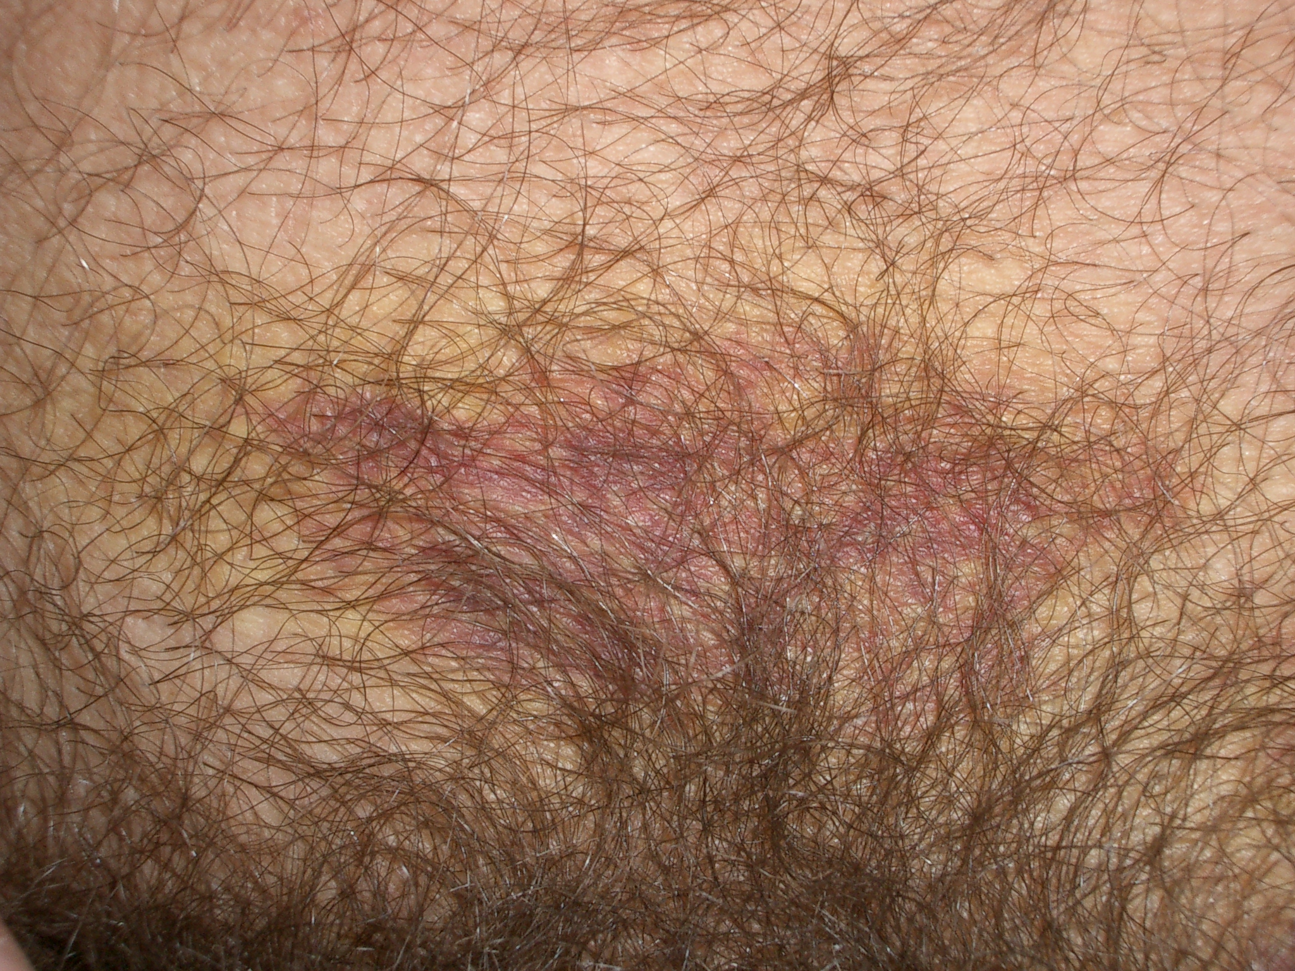
Normal abdomen bruise

Slide 101
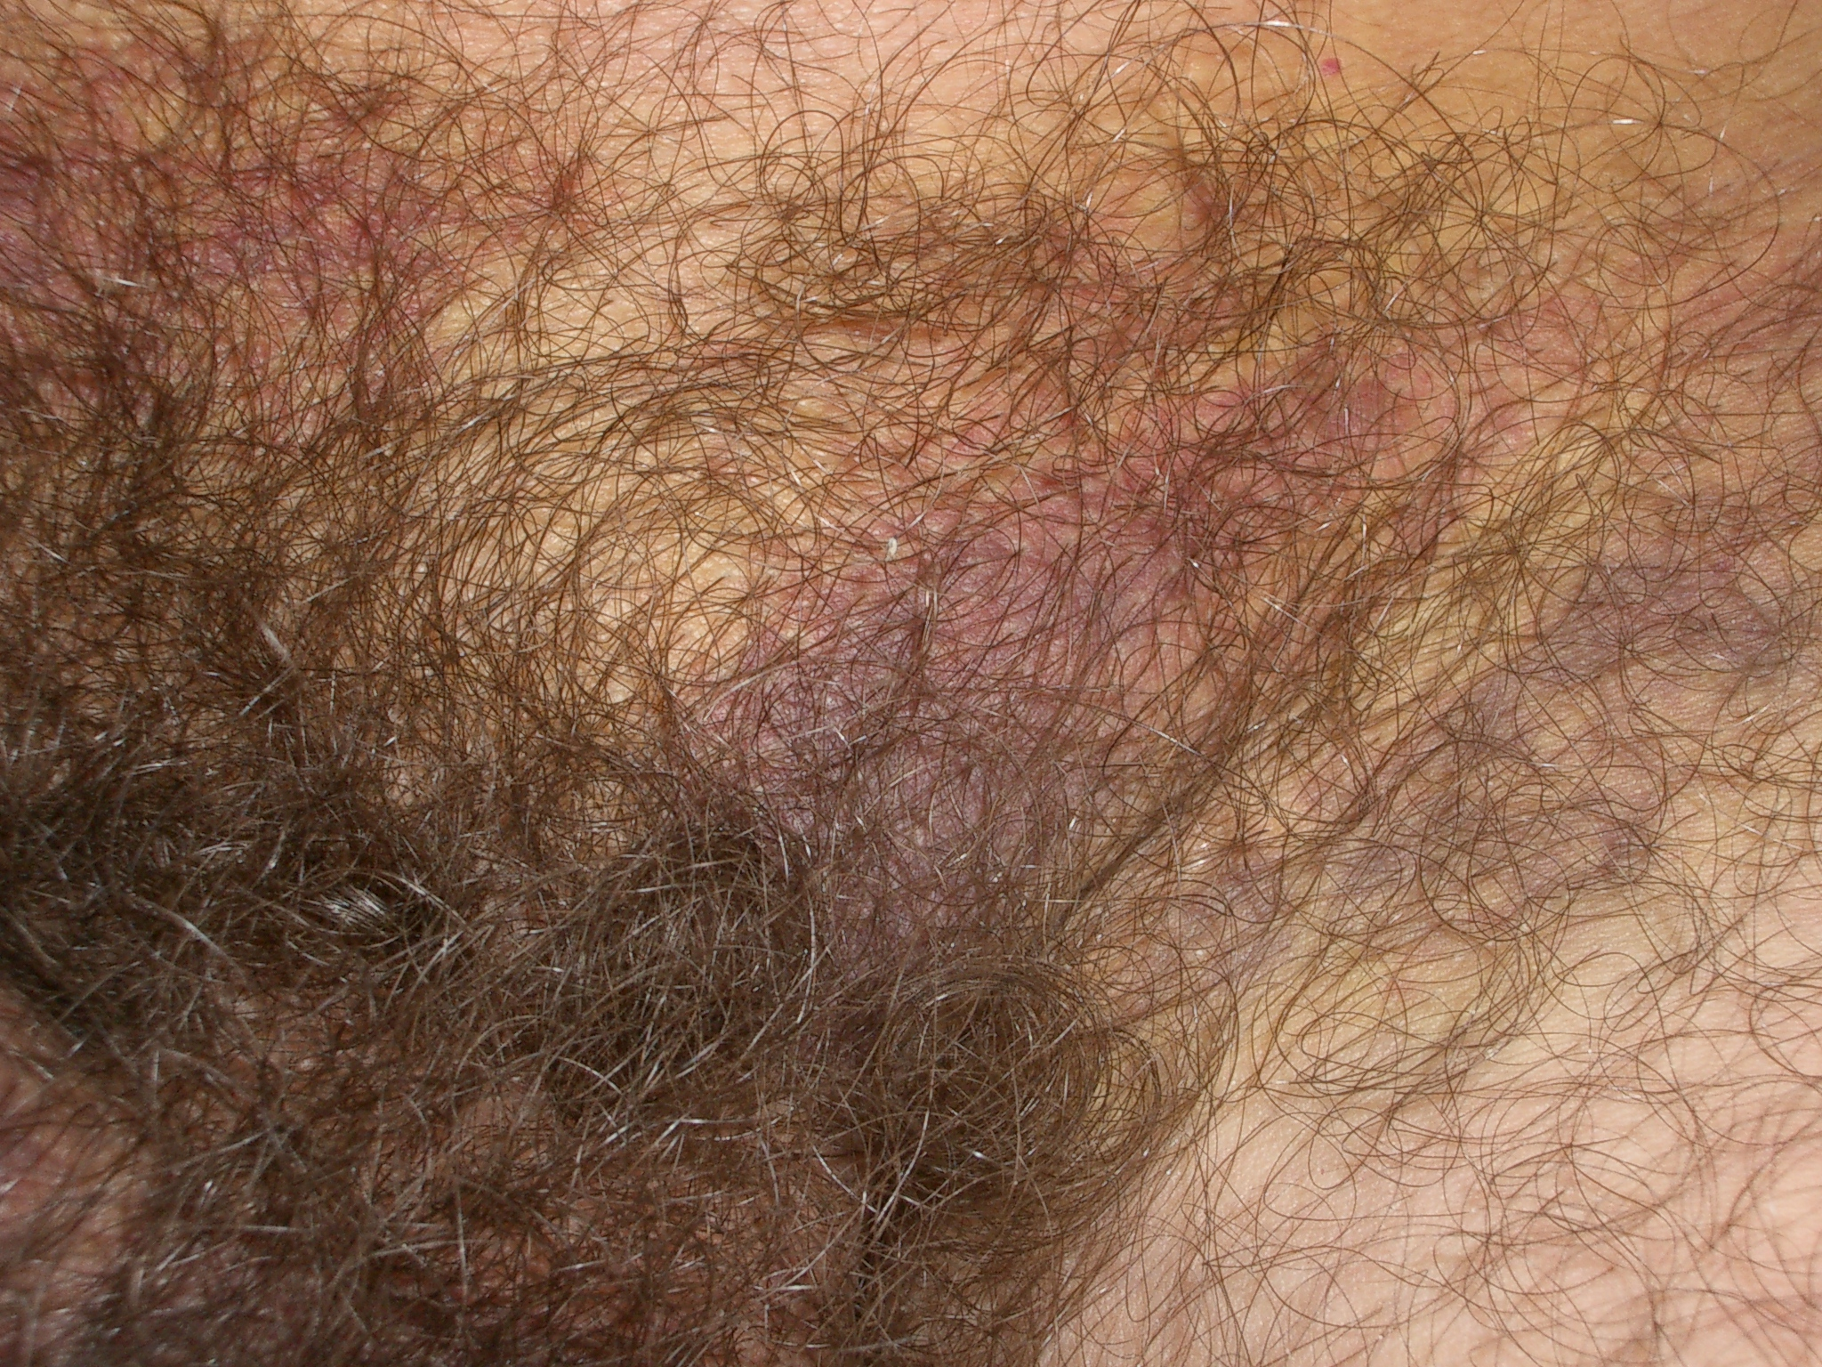
Normal thigh bruise

Slide 102
Bruising
Usually responds to
compression with jockstrap
rest
patience (will take time to resolve)
Invite in for exam if worsening

Slide 103
Tenderness in Clinic
Take good history (OLDECART)
examine for redness, pus, swelling, fever
can be
normal
infection
hematoma
granuloma

Slide 104
Tenderness in Clinic
Usually responds to
support
ibuprofen
ice
rest
Occasionally antibiotics
Rarely drainage of hematoma (very rarely)
Notes:
I think this is redundant too, but I liked the pics

Slide 105
Infection in Clinic
Symptoms
tenderness
redness
sometimes fever
sometimes pus

Slide 106
Infection in Clinic
Signs
swelling
redness
pus
tenderness at incision or deeply
warmth or fever

Slide 107
Treatment of Infection
Remove sutures if present
sutures not usually present in Li technique
Antibiotics
If early (2-3 days): cover skin pathogens (gram postive)
cephalexin 500mg po qid x 7 days, # 28
erythromycin base 333mg po tid x 7 days, # 21
If late (4-7 days) and : cover ano-rectal pathogens (gram positive and negative) +
levofloxacin 500 mg po die X 7 -10 days
amoxicillin 875 + clavulanic acid 125 mg po bid x 7-10 days
If epididymal infection suspected (sexually transmitted disease)
doxycycline 100 po bid x 7 days, # 14
Notes:
Keep it??

Slide 108
Further Treatment of Infection
scrotal support
ibuprofen
occasionally opioids (hydrocodone, etc.)
warm compresses
close follow-up
return right away if not improving
rarely need draining or surgical consult

Slide 109
Hematoma in Clinic
Approximately 1 to 5 % of vas cases
symptoms
tender swelling
size can vary from “grape” to “grapefruit”
often associated with bruising
can be quite painful
occur within days to a week of vasectomy

Slide 110
Hematoma
Notes:
I’m ambivalent about whether to keep this. My inclination is no.

Slide 111
Hematoma Treatment
scrotal support
ice
ibuprofen
time!
Explain these take up to 6 to 8 weeks to reabsorb
“like a goose-egg bump on your head”

Slide 112
Hematoma Treatment
If growing after compression, will need surgical consultation (very rare!)

Slide 113
Granuloma
a swelling of the vas tube at the severed end
occurs in about 1/3 of vasectomies
painful occasionally
usually resolve with
ibuprofen
support
time
Notes:
This we need

Slide 114
Summary
A vasectomy is a simple procedure
Many techniques exist
No-Scalpel technique has advantages
Complications are rare, but do occur
Most treatments are common sense
Do integrate this into your practice

